Slide 1
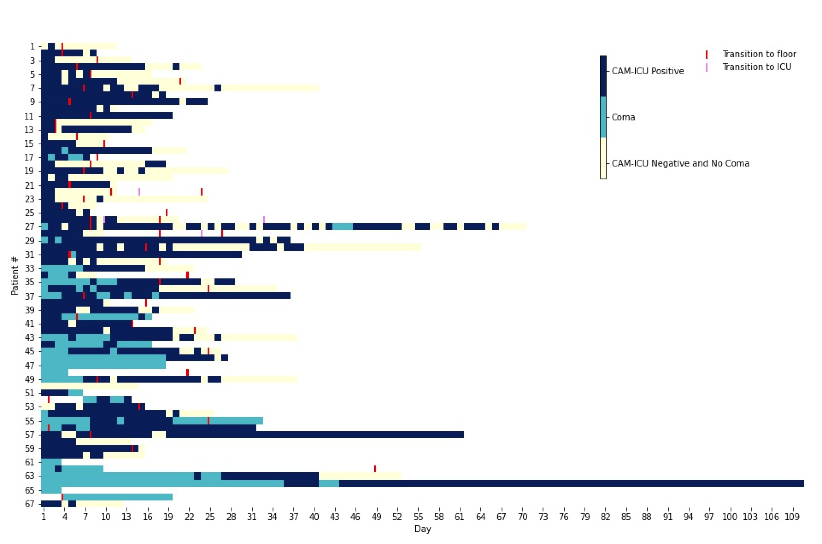
Delirium Prevalence and Outcomes in Critically Ill Patients with COVID-19: A Quality Improvement Study
Abigail A. Bucklin^{1,2}, Wolfgang Ganglberger^{1,2}, Susan M. Maher³, Syed Quadri^{1,2}, Preeti Malik^{1,2}, Muhammad Abubakar Ayub^{1,2}, Miguel Alejandro Patino Montoya³, Haitham Samir Alabsi¹, Jeanine Wiener-Kronish³, M. Brandon Westover^{1,2}
¹ Department of Neurology, Massachusetts General Hospital (MGH), Boston, MA
²Clinical Data Animation Center (CDAC), Boston, MA
³Department of Anesthesia, Critical Care and Pain Medicine, Massachusetts General Hospital (MGH), Boston, MA
Background
Results
Results
There is a need to track the prevalence and severity of delirium in COVID-19 patients to identify opportunities to prevent or decrease delirium in this patient population.
Figure 1: Swimmer plot showing whether patients are CAM-ICU negative (no delirium) and no coma, comatose, or CAM-ICU positive (delirious). Each bin represents one day. Transitions from the ICU to the floor, and from the floor back to the ICU are indicated on the plots.
5 patients were comatose the duration of the study.
Of the 62 patients with delirium assessments, 61 (98%) were delirious at least 1 day.
Over 90% of patients received opioids, benzodiazepines, propofol at least once during hospitalization.
At three months, 62% of patients showed impaired cognition, 51% low quality of life, and 16% depression.
Patients in top half of delirium exposure showed worse cognition, worse quality of life and worse depression than patients in bottom half of delirium exposure.
Objectives
Investigate the prevalence and severity of delirium in critically ill COVID-19 patients
Investigate the impact of delirium on cognition and quality of life at 3-month follow up after hospitalization.
Report our findings to hospital leadership in order to improve sedation practices and delirium prevention in COVID-19 patients.
Methods
Patients with confirmed COVID-19 were eligible if they were:
in the ICU, mechanically ventilated, receiving IV sedatives
were undergoing urgent inpatient electroencephalographic monitoring
67 patients were enrolled
Coma status was determined using the Richmond Agitation Sedation Scale (RASS). Patients determined to be non-comatose (RASS > -4) were assessed using the Confusion Assessment Method (CAM-ICU) to determine delirium status (CAM-ICU positive or negative).
Cognition and quality of life were assessed via phone interview 3 months after enrollment in the study.
Conclusions
Delirium prevalence and severity is widespread in patients admitted to the ICU with COVID-19. All but one patient was delirious for at least one day during their hospitalization. Many patients experienced cognitive difficulties and decreased quality of life post-discharge.

